Slide 1

CALCULUS
Book: Calculus Author:James Stewart 8th Edition, Cengage Learning, 2015

Slide 2
Thông tin Giảng viên:
Giảng viên: Trần Trịnh Mạnh Dũng.
Email liên hệ: dungttm12@fpt.edu.vn
Số điện thoại: 090 813 2206 (Zalo, chỉ sử dụng khi cấp thiết)
Có tất cả 6 bài kiểm tra thường kỳ (60%) và 1 bài kiểm tra cuối kỳ (40%).

Slide 3
CALCULUS
Chapter 1 Functions and Limits

Slide 4
1.1. Functions and Their Representations

Slide 5
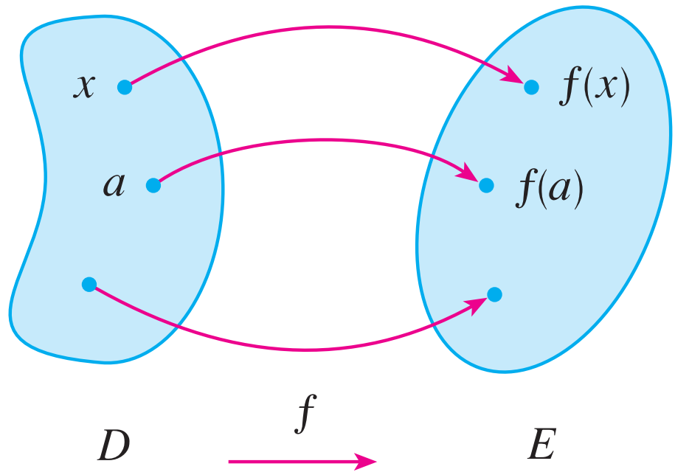
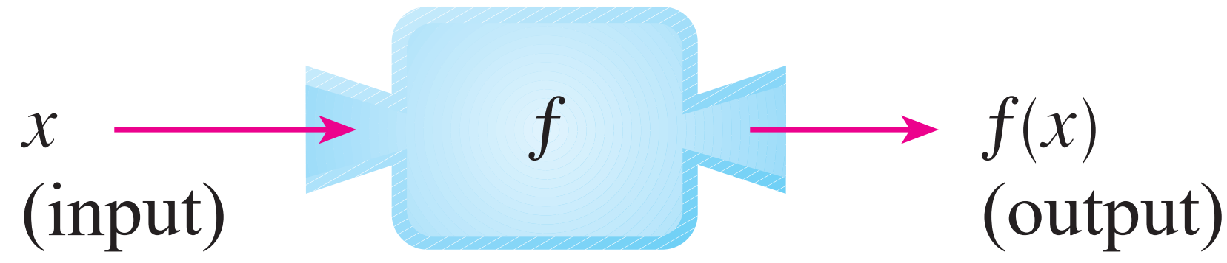
FUNCTION
A function f is a rule that assigns to each element x in a set D exactly one element, called f(x), in a set E.
The set D is called the domain of the function f.
The range of f is the set of all possible values of f(x) as x varies throughout the domain.

Slide 6
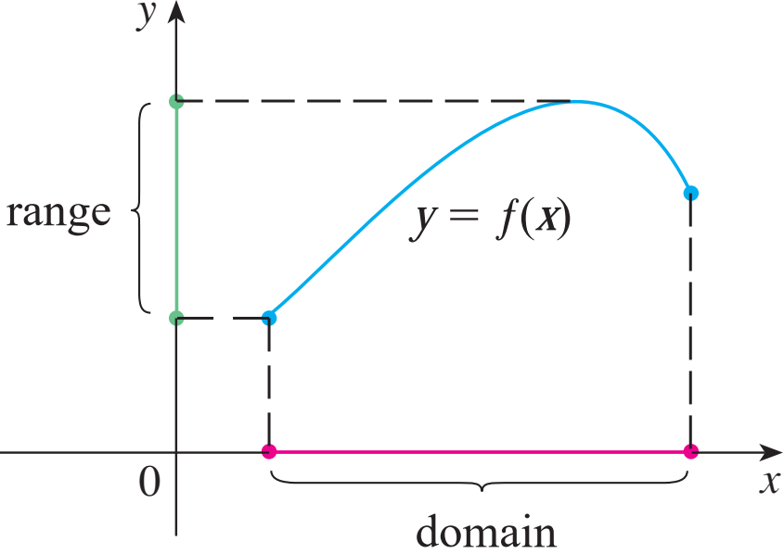
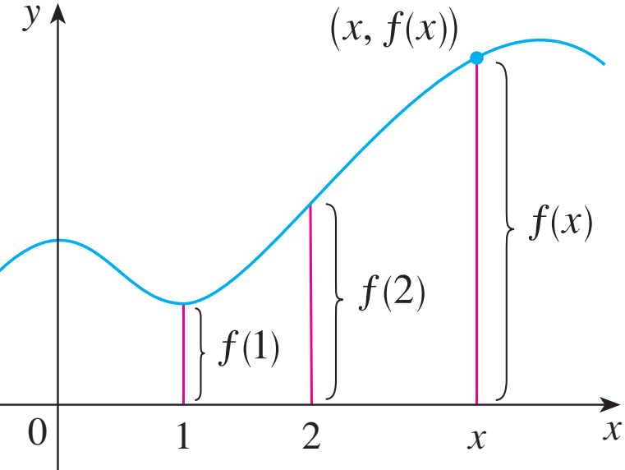

GRAPH
The graph of f is the set of all points (x, y) in the coordinate plane such that y = f(x) and x is in the domain of f.
$${\text{G}}_{\text{f}} \text{= }\left\{\left(\text{x}\text{, }\text{y}\right)\text{| }\text{y}\text{ = }\text{f}\left(\text{x}\right)\text{, }\text{x} \text{∈ }\text{D}\right\}$$
The graph of f also allows us to picture:
The domain of f on the x-axis
Its range on the y-axis

Slide 7
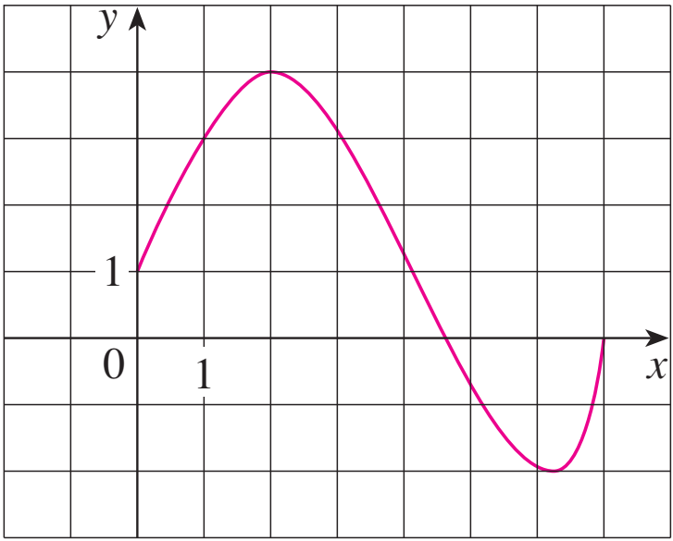
GRAPH
The graph of a function f is shown.
Find the values of f(1) and f(5) ?
What is the domain and range of f ?
f(1) = 3
f(5) ≈ - 0.7
D = [0, 7]
Im(f) = [-2, 4]

Slide 8
Remind:

Slide 9
REPRESENTATIONS OF FUNCTIONS
There are four possible ways to represent a function:
Algebraically (by an explicit formula)
Visually (by a graph)
Numerically (by a table of values)
Verbally (by a description in words)

Slide 10
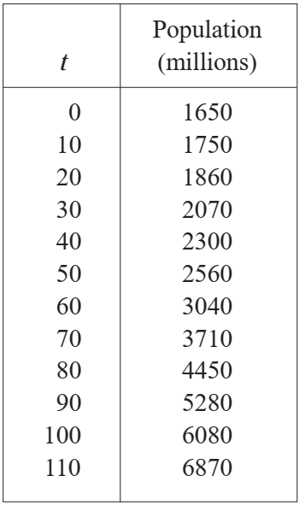
Example (the function is described in table):
The human population of the world P depends on the time t.
The table gives estimates of the world population P(t) at time t, for certain years.
However, for each value of the time t, there is a corresponding value of P, and we say that P is a function of t.

Slide 11
REPRESENTATIONS OF FUNCTIONS
A curve in the xy-plane is the graph of a function of x if and only if no vertical line intersects the curve more than once.

Slide 12
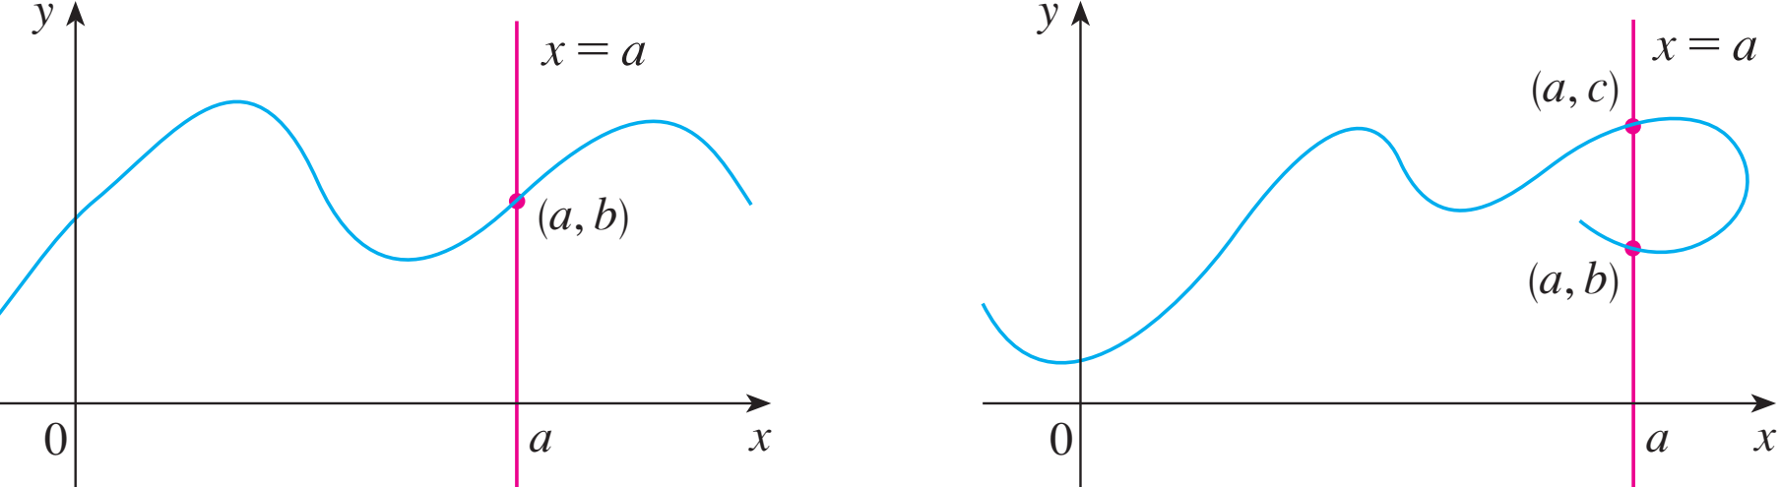
THE VERTICAL LINE TEST
The reason for the truth of the Vertical Line Test can be seen in the figure.

Slide 13
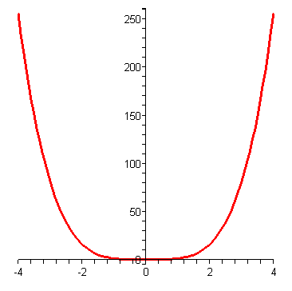
SYMMETRY: EVEN FUNCTION
If a function f satisfies:
f(-x) = f(x), ∀x ∈ D
then f is called an even function.
The geometric significance of an even function is that its graph is symmetric with respect to the y-axis.
y = x⁴

Slide 14
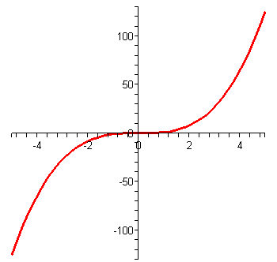
y = x³
SYMMETRY: ODD FUNCTION
If a function f satisfies:
f(-x) = - f(x), ∀x ∈ D
then f is called an odd function.
The graph of an odd function is symmetric about the origin.

Slide 15
Example: Let f is an odd function. If (-3, 5) is in the graph of f then which point is also in the graph of f ?
A. (3, 5). B. (-3, -5).
C. (3, -5). D. All of the others.

Slide 16
Example: Suppose f is an odd function and g is an even function.
What can we say about the function f.g defined by ( f.g)(x) = f(x)g(x)?
Prove your result.

Slide 17
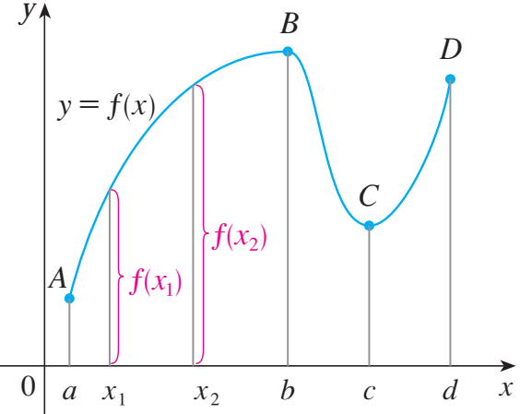
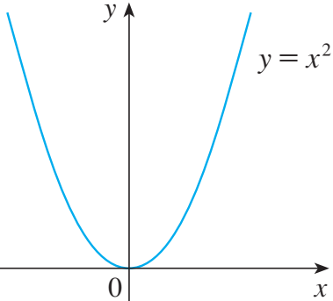
INCREASING AND DECREASING FUNCTIONS
A function f is called increasing on an interval I if:
f(x₁) < f(x₂) whenever x₁ < x₂ in I
It is called decreasing on I if:
f(x₁) > f(x₂) whenever x₁ < x₂ in I

Slide 18
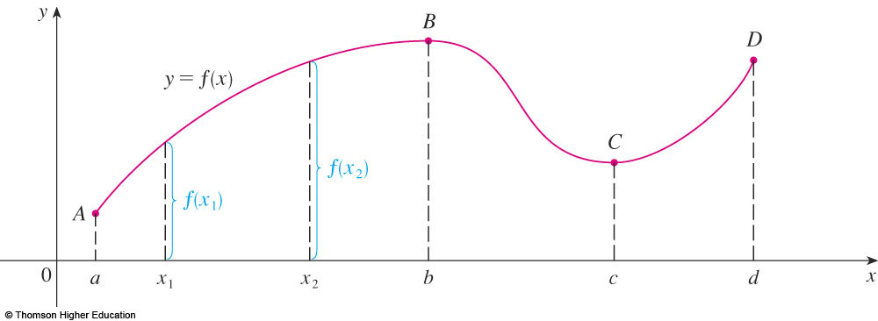
INCREASING AND DECREASING FUNCTIONS
The function f is said to be increasing on the interval [a, b], decreasing on [b, c], and increasing again on [c, d ].

Slide 19
QUIZ QUESTIONS
1. If f is a function then f(x + 2) = f(x) + f(2).
a. True b. False
2. If f(s) = f(t) then s = t.
a. True b. False
3. Let f be a function.
We can find s and t such that s = t and f(s) is not equal to f(t).
a. True b. False

Slide 20
1.2. MATHEMATICAL MODELS: A CATALOG OF ESSENTIAL FUNCTIONS
In this section, we will learn about:
The purpose of mathematical models.

Slide 21
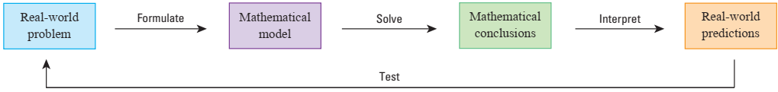
MATHEMATICAL MODELS
A mathematical model is a mathematical
Description ≝ often by means of a function or an
Equation ≝ of a real-world phenomenon such as:
Size of a birth
Cost of emispopulation
Demand for a product
Speed of a falling object
Life expectancy of a person at sion reductions

Slide 22
LINEAR MODELS
When we say that y is a linear function of x, we mean that the graph of the function is a line.
So, we can use the slope-intercept form of the equation of a line to write a formula for the function as
where m is the slope (độ dốc) of the line and b is the y-intercept.

Slide 23
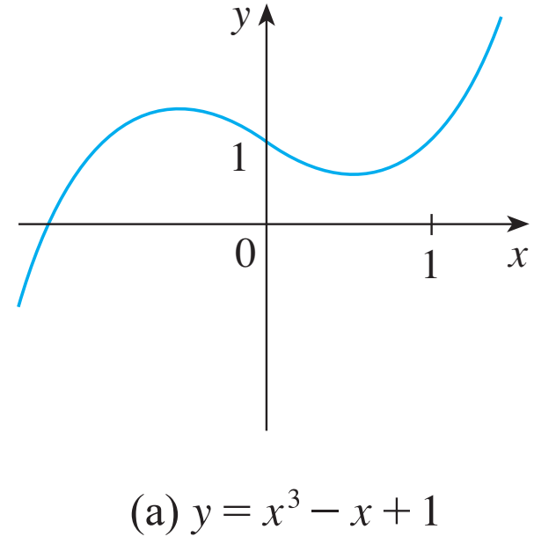
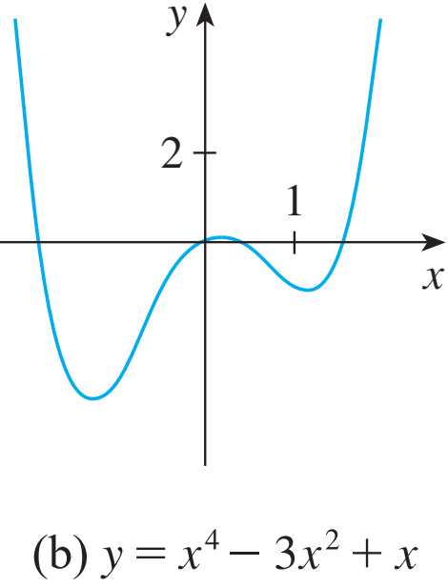
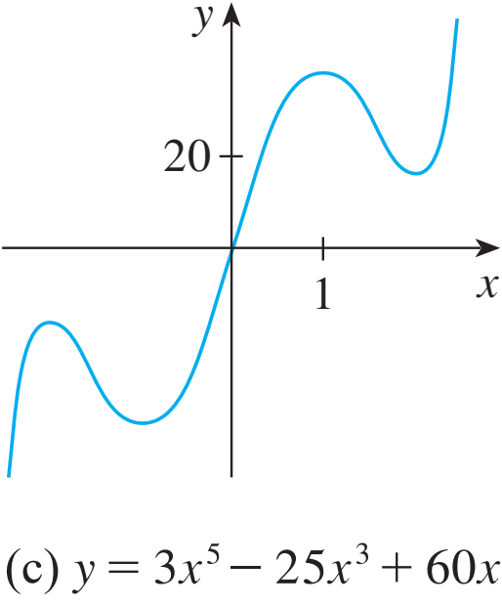
POLYNOMIALS
A function P is called a polynomial if
where n is a nonnegative integer and the numbers a₀, a₁, a₂, …, a_{n} are constants called the coefficients of the polynomial.
Desmos

Slide 24
RATIONAL FUNCTIONS
A rational function f is a ratio of two polynomials
where P and Q are polynomials.
The domain consists of all values of x such that Q(x) ≠ 0.

Slide 25
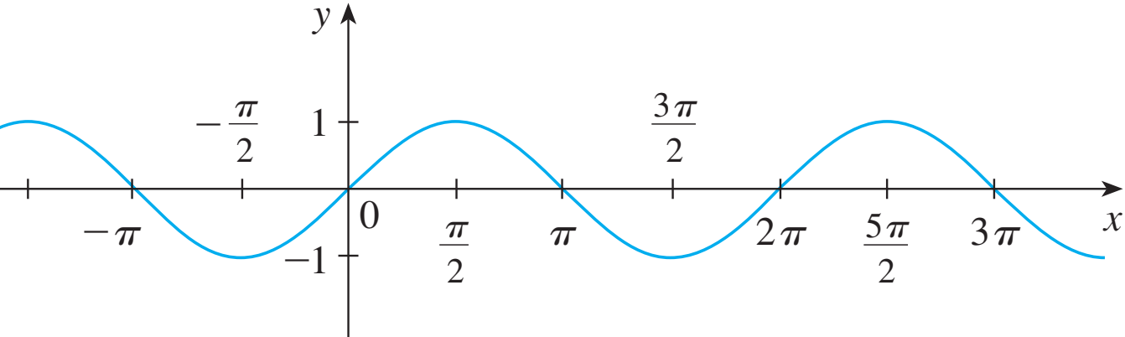
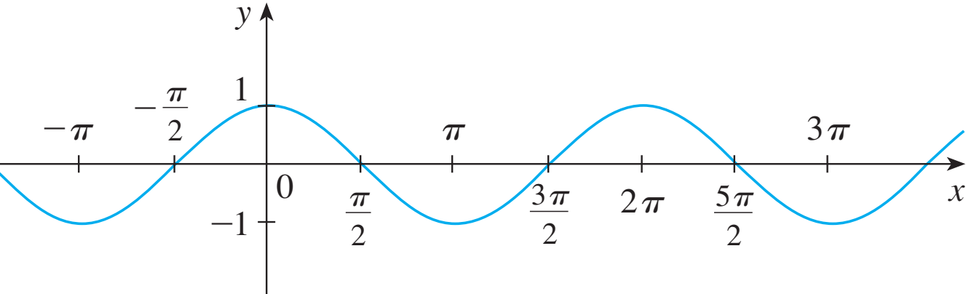
TRIGONOMETRIC FUNCTIONS
Remind:

Slide 26
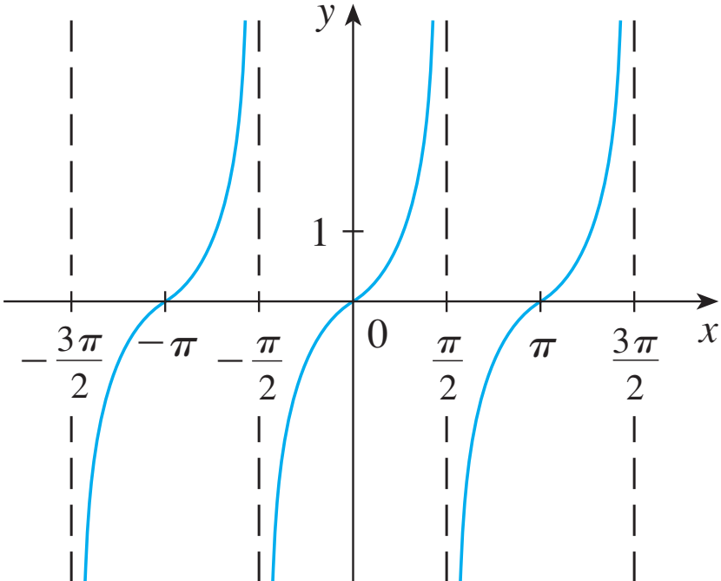
TRIGONOMETRIC FUNCTIONS
Remind:

Slide 27
TRIGONOMETRIC FUNCTIONS
The reciprocals of the sine, cosine, and tangent functions are

Slide 28
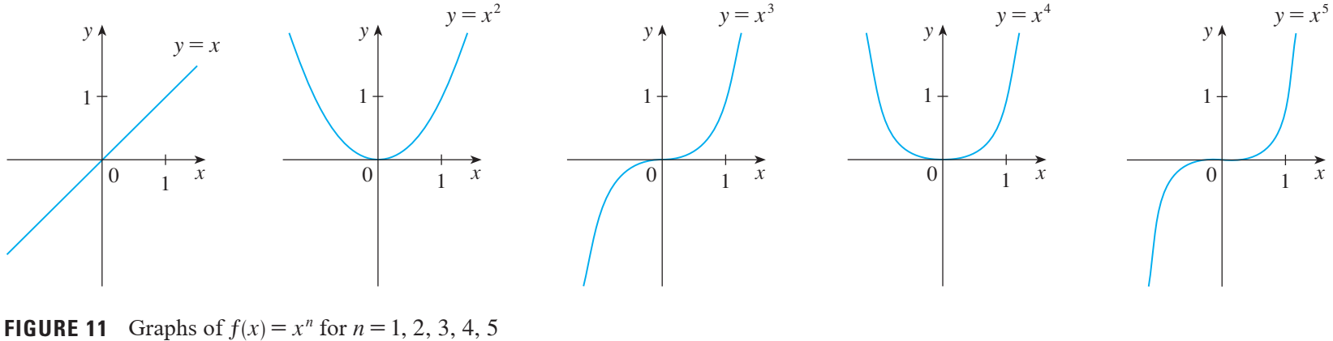

POWER FUNCTIONS
A function of the form $\text{f} \left(\text{x}\right) \text{=}{ \text{x}}^{\text{a}}$ where a is constant, is called a power function.

Slide 29
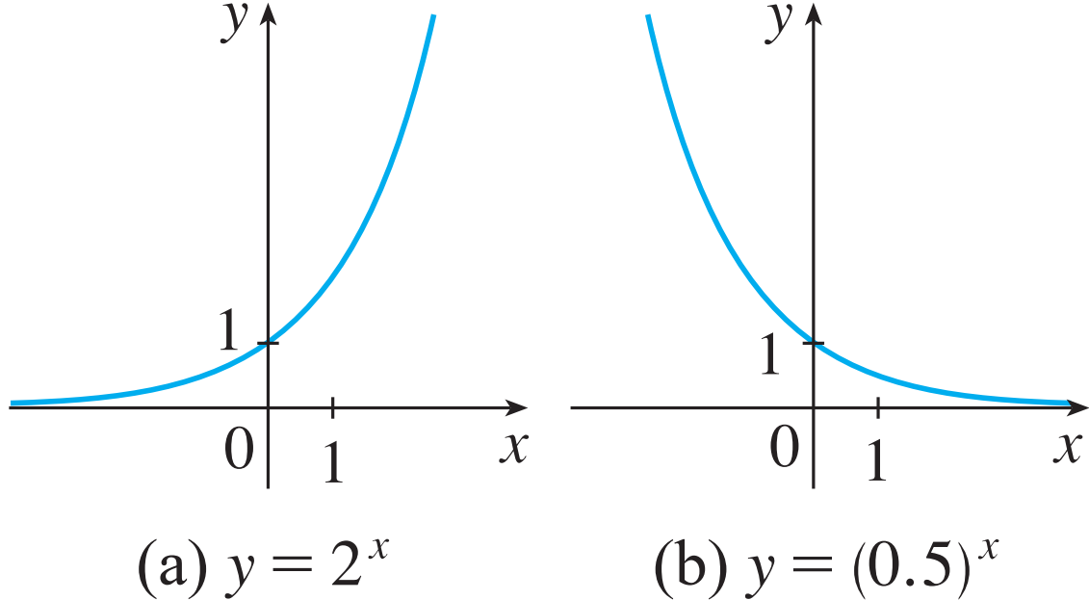
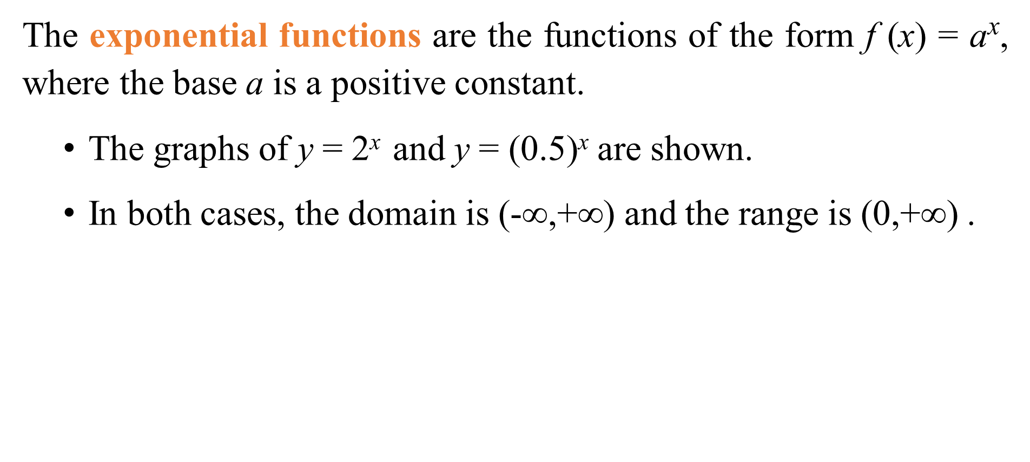
EXPONENTIAL FUNCTIONS
The exponential functions are the functions of the form f (x) = a^{x}, where the base a is a positive constant.
The graphs of y = 2^{x} and y = (0.5)^{x} are shown.
In both cases, the domain is $\text{(−}\text{∞,+∞)}$ and the range is $\text{(}\text{0}\text{,+∞)}$ .

Slide 30
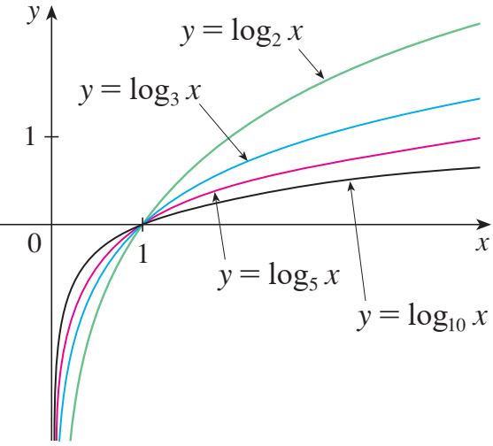
LOGARITHMIC FUNCTIONS
The logarithmic functions
, where the base a is a positive constant, are the inverse functions of the exponential functions.
The figure shows the graphs of four logarithmic functions with various bases.

Slide 31
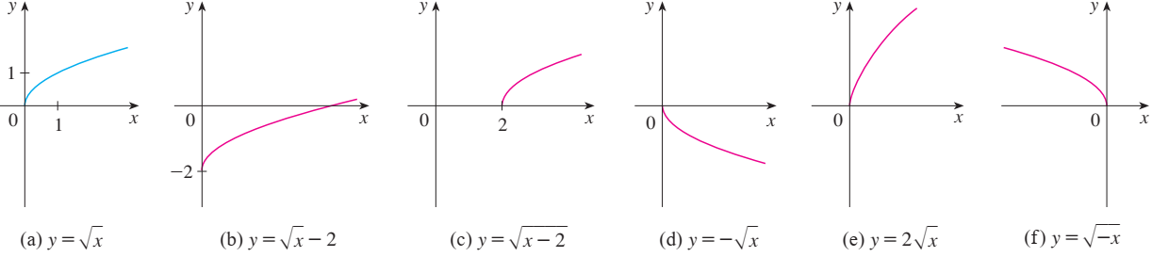
TRANSFORMATIONS
Label the following graph from the graph of the function y = f(x) shown in the part (a):
y = f(x) – 2; y = f(x – 2); y = – f(x); y = 2f(x); y = f(– x)?

Slide 32
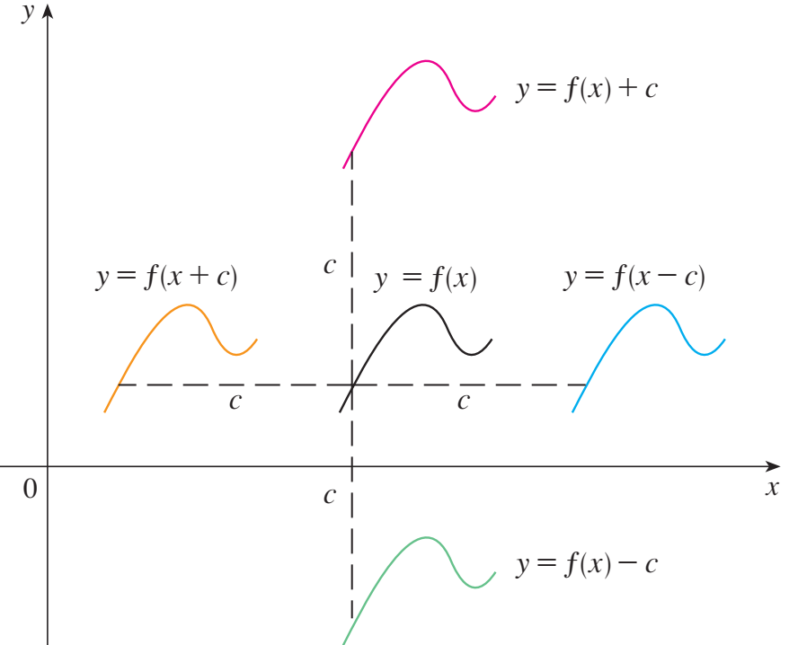
SHIFTING
Why don’t we consider the case c<0?
Suppose c > 0.
To obtain the graph of y = f(x) + c, shift the graph of y = f(x) a distance c units upward.
To obtain the graph of y = f(x) - c, shift the graph of y = f(x) a distance c units downward.

Slide 33
SHIFTING
Suppose c > 0.
To obtain the graph of y = f(x - c), shift the graph of y = f(x) a distance c units to the right.
To obtain the graph of y = f(x + c), shift the graph of y = f(x) a distance c units to the left.

Slide 34
NEW FUNCTIONS FROM OLD FUNCTIONS
Label the following graph from the graph of the function y = f(x) shown in the part (a):
y = f(x) – 2; y = f(x – 2); y = – f(x); y = 2f(x); y = f(– x)?

Slide 35
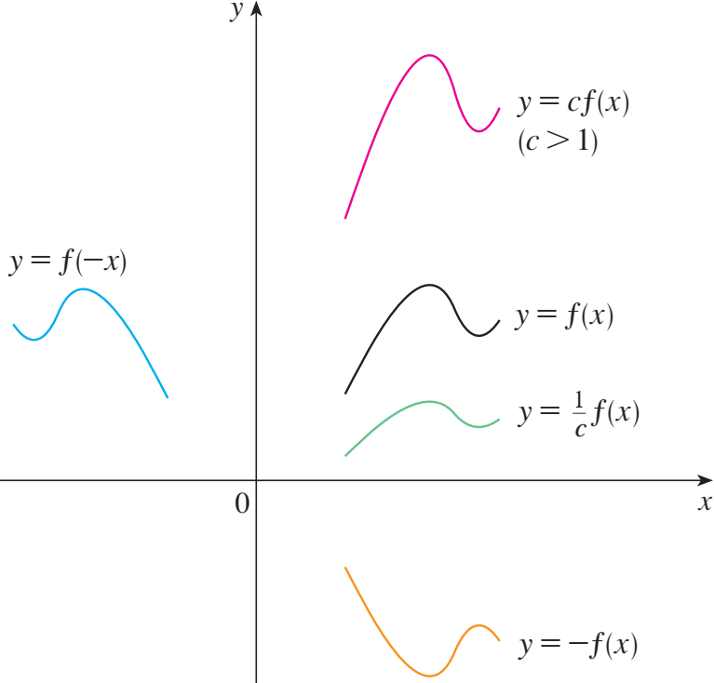
TRANSFORMATIONS
How about the case c<1?
Suppose c > 1.
To obtain the graph of y = cf(x), stretch the graph of y = f(x) vertically by a factor of c.
To obtain the graph of y = (1/c)f(x), compress the graph of y = f(x) vertically by a factor of c.

Slide 36
TRANSFORMATIONS
Suppose c > 1.
In order to obtain the graph of y = f(cx), compress the graph of y = f(x) horizontally by a factor of c.
To obtain the graph of y = f(x/c), stretch the graph of y = f(x) horizontally by a factor of c.

Slide 37
TRANSFORMATIONS
Suppose c > 1.
In order to obtain the graph of y = -f(x), reflect the graph of y = f(x) about the x-axis.
To obtain the graph of y = f(-x), reflect the graph of y = f(x) about the y-axis.

Slide 38
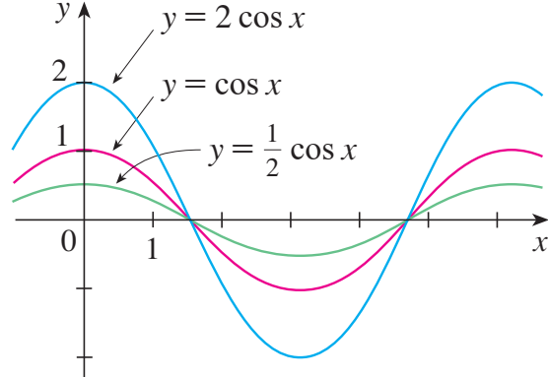
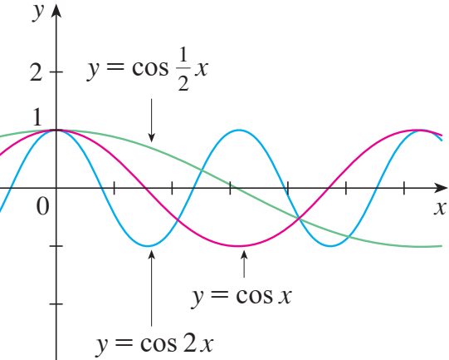
TRANSFORMATIONS
The figure illustrates these stretching transformations when applied to the cosine function with c = 2.

Slide 39
Example:
Suppose that the graph of f is given. Describe how the graph of the function f(x – 2) + 2 can be obtained from the graph of f. Select the correct answer.
a. Shift the graph 2 units to the left and 2 units down.
b. Shift the graph 2 units to the right and 2 units down.
c. Shift the graph 2 units to the right and 2 units up.
d. Shift the graph 2 units to the left and 2 units up.
e. None of these

Slide 40
COMBINATIONS OF FUNCTIONS
Two functions f and g can be combined to form new functions:
(f + g)(x) = f(x) + g(x)
(f – g)(x) = f(x) – g(x)

Slide 41
Quiz Question:
Let h(x) = f(g(x)).
If g(x) = x – 1 and h(x) = 3x + 2 then f(x) is:
3x + 3 b. 3x + 4 c. 3x + 1 d. None of them
2) If h(x) = 3x + 2 and f(x) = x – 1 then g(x) is:
a. 3x + 3 b. 3x + 4 c. 3x + 1 d. None of them

Slide 42
1.3. THE LIMIT OF A FUNCTION
In this section, we will learn:
About limits in general and about numerical and graphical methods for computing them.

Slide 43
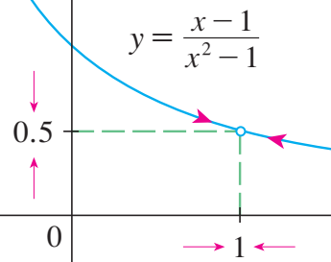
THE LIMIT OF A FUNCTION
In general, we write
“the limit of f(x), as x approaches a, equals L”
if we can make the values of f(x) arbitrarily close to L by taking x to be sufficiently close to a but not equal to a.

Slide 44

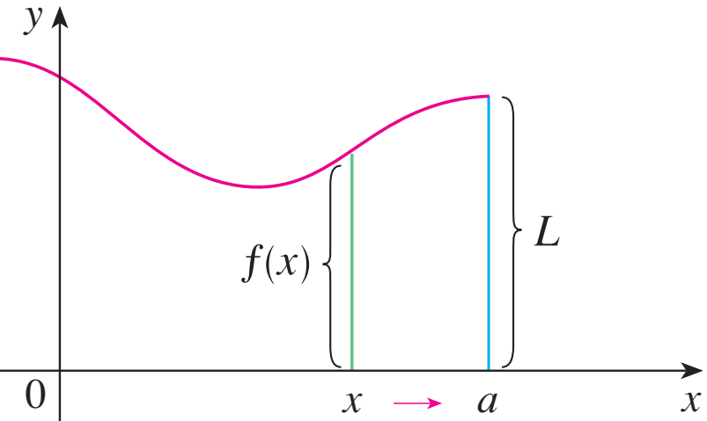
ONE-SIDED LIMITS
In general, we write
“the left-hand limit of f(x) as x approaches a.”
if we can make the values of f(x) arbitrarily close to L by taking x to be sufficiently close to a and x less than a.

Slide 45

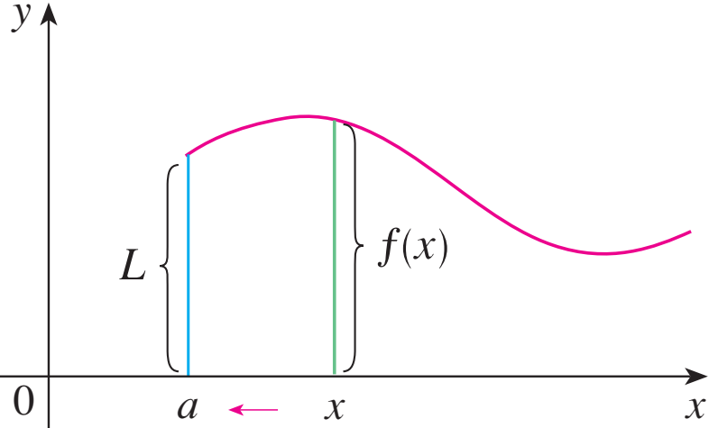
ONE-SIDED LIMITS
In general, we write
“the right-hand limit of f(x) as x approaches a.”
if we can make the values of f(x) arbitrarily close to L by taking x to be sufficiently close to a and x greater than a.

Slide 46
ONE-SIDED LIMITS
In general, we write
“the right-hand limit of f(x) as x approaches a.”
if we can make the values of f(x) arbitrarily close to L by taking x to be sufficiently close to a and x greater than a.

Slide 47
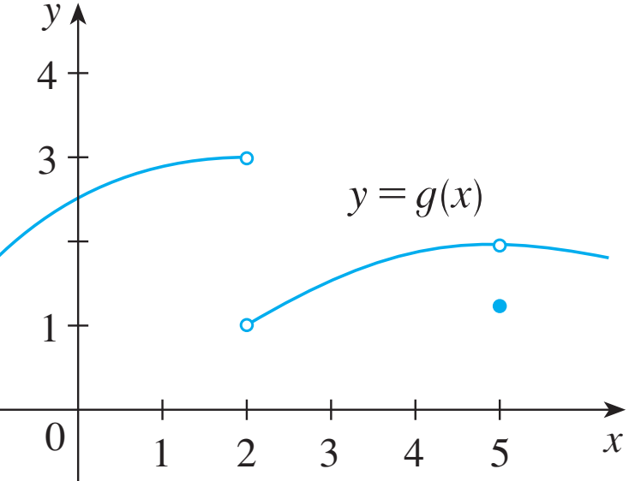
ONE-SIDED LIMITS

Slide 48
ONE-SIDED LIMITS
Theorem:

Slide 49
1.4. Calculating Limits Using the Limit Laws
In this section, we will:
Use the Limit Laws to calculate limits.

Slide 50
THE LIMIT LAWS
Suppose that c is a constant and the limits and exist. Then

Slide 51
USING THE LIMIT LAWS
Let n is a positive integer.

Slide 52
Basic Limit Formula

Slide 53
Indeterminate form
There are seven indeterminate forms:
Example: Calculate the following limits.

Slide 54
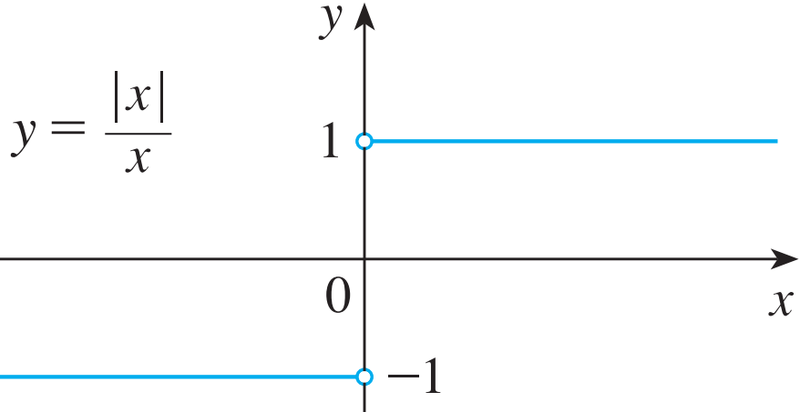
DIRECT SUBSTITUTION PROPERTY
We state this fact as follows. If f is a polynomial or a rational function and a is in the domain of f, then
Theorem 1: if and only if .
Prove that does not exist.

Slide 55
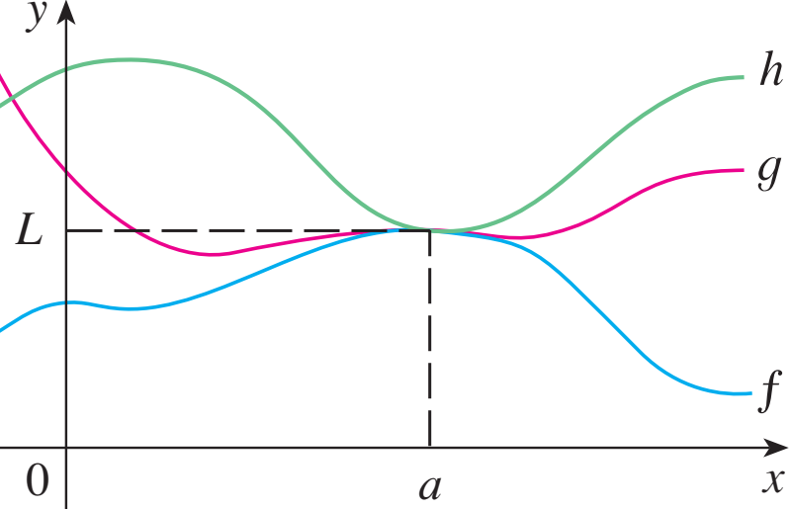
PROPERTIES OF LIMITS
Theorem 2:
If when x is near a (except possibly at a) and the limits of f and g both exist as x approaches a, then
Theorem 3: The Squeeze Theorem (the Sandwich Theorem or the Pinching Theorem)
If when x is near a (except possibly at a) and .Then

Slide 56
USING THE LIMIT LAWS
Example: Show that
Note that we cannot use
This is because does not exist.

Slide 57
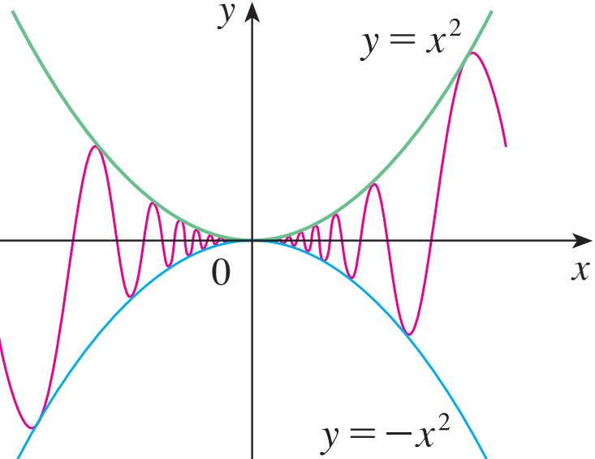
USING THE LIMIT LAWS
Example: Show that
However, since
We have:
Taking f(x) = – x², and h(x) = x² in the Squeeze Theorem,
We obtain:

Slide 58
QUIZ QUESTIONS
1. If then
a. True b. False
2. If
a. True b. False

Slide 59
QUIZ QUESTIONS
1. If then
a. True b. False
2. If
a. True b. False

Slide 60
1.5. CONTINUITY
In this section, we will:
See that the mathematical definition of continuity corresponds closely with the meaning of the word continuity in everyday language.

Slide 61
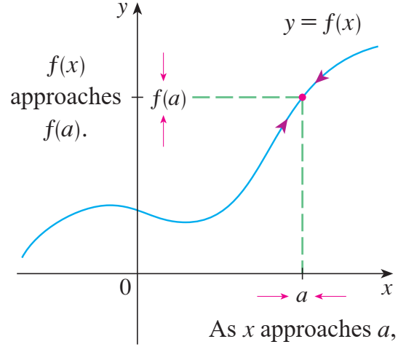
CONTINUITY
Definition: A function f is continuous at a number a if:
Notice that:
f(a) is defined - that is, a is in the domain of f
exists

Slide 62
CONTINUITY
Definition: A function f is continuous at a number a if:
Notice that:
f(a) is defined - that is, a is in the domain of f
exists

Slide 63
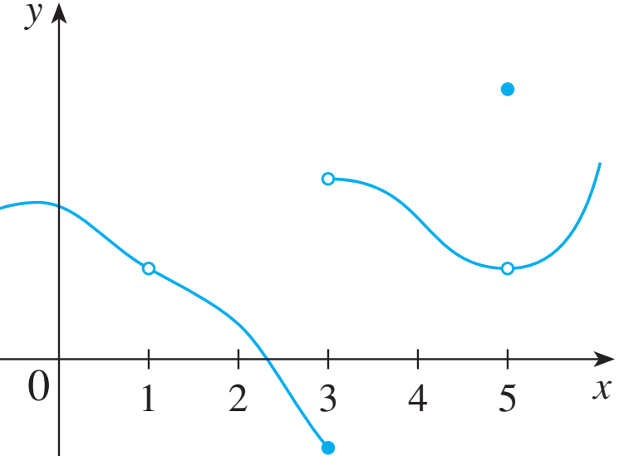
CONTINUITY
The definition says that f is continuous at a if f(x) approaches f(a) as x approaches a.
If f is defined near a (in other words, f is defined on an open interval containing a, except perhaps at a), we say that f is discontinuous at a (or f has a discontinuity at a) if is not continuous at
The figure shows the graph of a function f.
At which numbers is f discontinuous?
Why ?

Slide 64
CONTINUITY
The definition says that f is continuous at a if f(x) approaches f(a) as x approaches a.
If f is defined near a (in other words, f is defined on an open interval containing a, except perhaps at a), we say that f is discontinuous at a (or f has a discontinuity at a) if is not continuous at

Slide 65
Example:
Consider the continuity of the following function at x = 0:
Domain:
We get:
Case 1: (m = 1) ⇒ f(x) is continuous at x = 0.
Case 2: (m ≠ 1) ⇒ f(x) is discontinuous at x = 0.

Slide 66
CONTINUITY
Definition:
A function f is continuous from the right at a number a if
and f is continuous from the left at a if
Theorem:

